Slide 1
Team:
Still Loading
◆ Project 1: Snake Game (C )
◆ Project 2: CNC Plotter (Arduino)

Slide 2
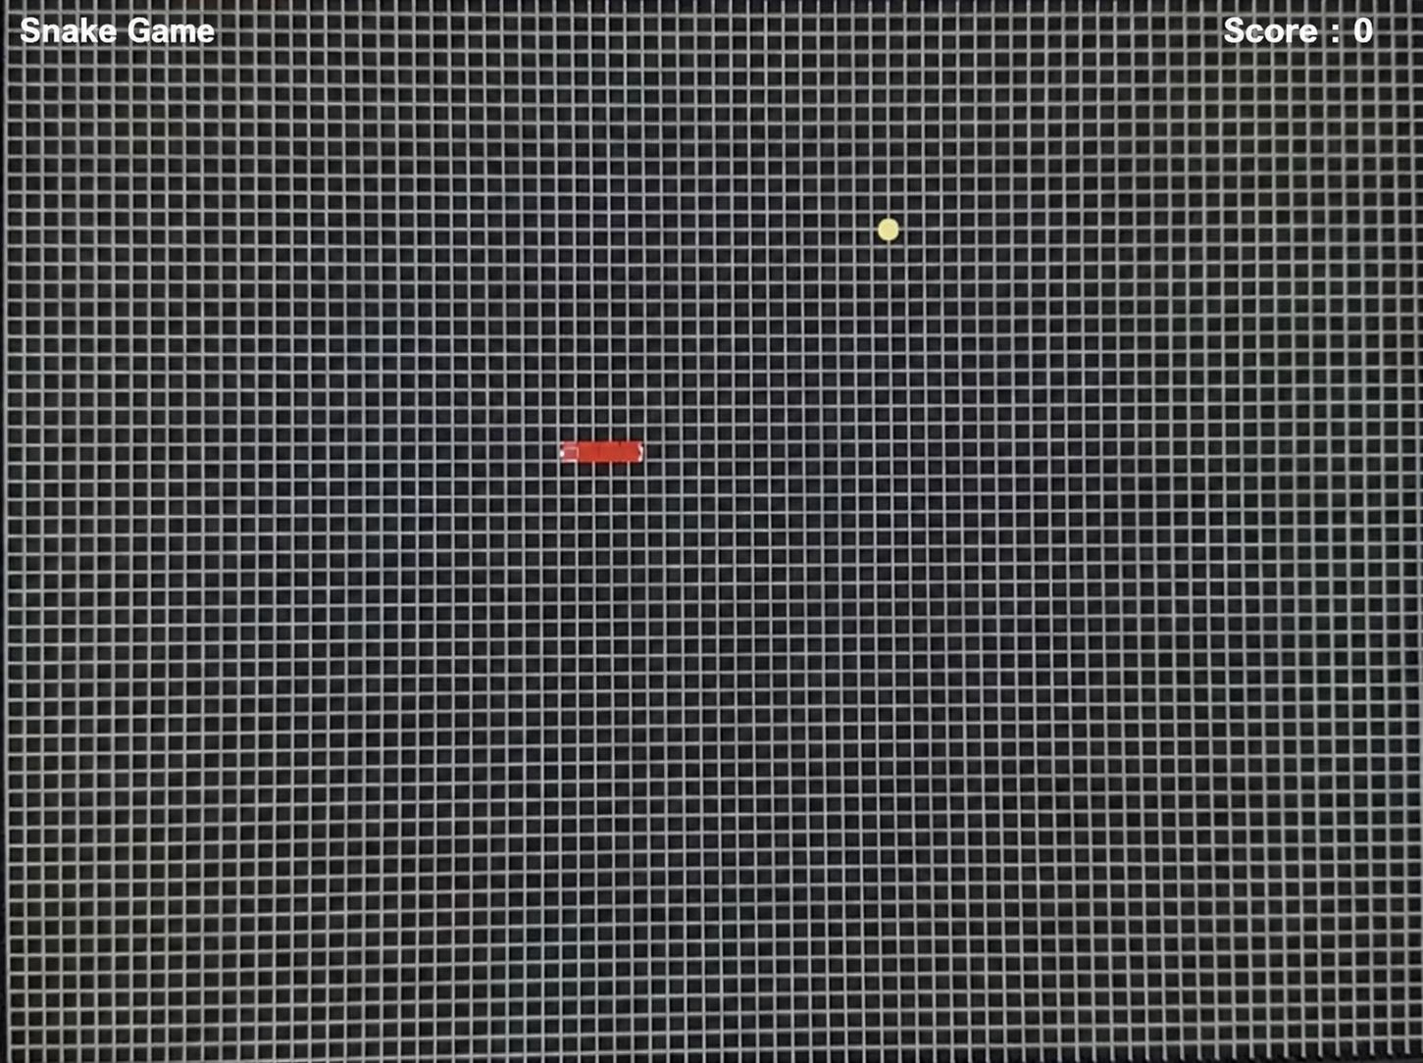
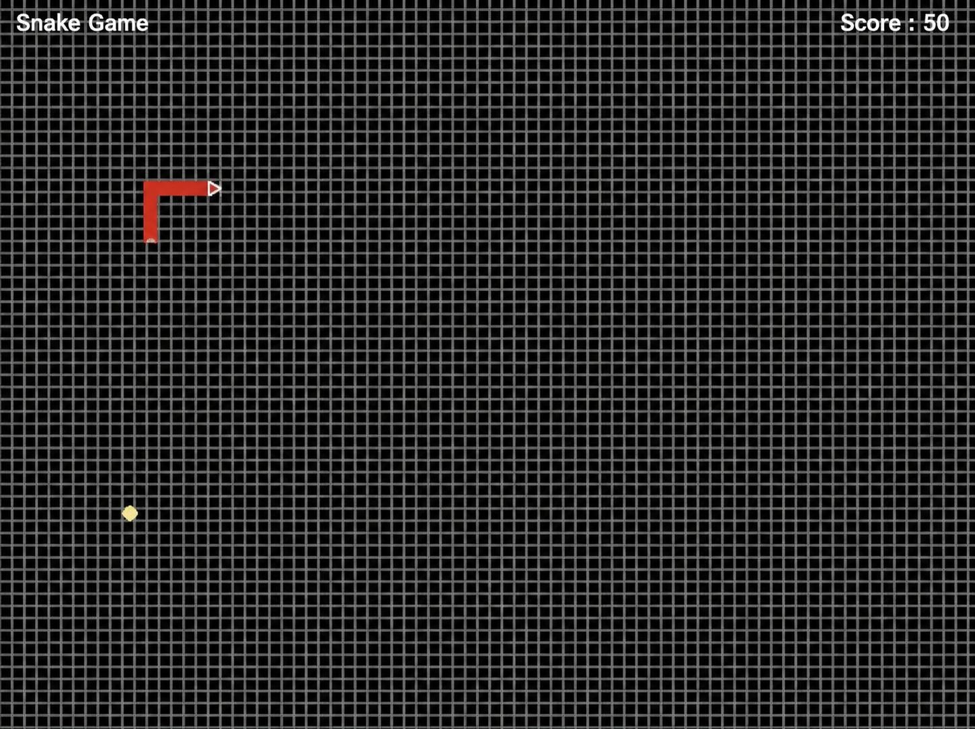
🐍 Snake Game
Project Name - Language
Snake Game – C using Graphics.h
Brief Description
This project is a classic Snake Game developed using C language and the graphics.h library . The player controls a snake that moves around the screen to eat food . Each time the snake eats food, it grows longer and the score increases . The game ends if the snake hits the wall or collides with itself.
How to Use
Use W, A, S, D keys to control the snake direction: W → Up S → Down A → Left D → Right
Eat the yellow food to increase your score and snake length
Avoid hitting the walls or the snake’s own body
The game ends when a collision occurs

Slide 3
💻 Snake Game (Final Code)
#include <graphics.h>
#include <conio.h>
#include <dos.h>
#include <stdlib.h>
#include <stdio.h>
int x[50], y[50];
int length = 5;
int foodx, foody;
char dir = 'R';
int score = 0;
void drawGrid() {
int i;
setcolor(LIGHTGRAY);
for(i = 0; i < 640; i += 8)
line(i, 0, i, 480);
for(i = 0; i < 480; i += 8)
line(0, i, 640, i);
}
void drawSnake() {
int i;
for(i = 1; i < length-1; i++) {
setfillstyle(SOLID_FILL, RED);
bar(x[i], y[i], x[i]+8, y[i]+8);
}
setfillstyle(SOLID_FILL, RED);
bar(x[0], y[0], x[0]+8, y[0]+8);
setcolor(WHITE);
if(dir == 'R') {
circle(x[0]+6, y[0]+2, 1);
circle(x[0]+6, y[0]+6, 1);
} else if(dir == 'L') {
circle(x[0]+2, y[0]+2, 1);
circle(x[0]+2, y[0]+6, 1);
} else if(dir == 'U') {
circle(x[0]+2, y[0]+2, 1);
circle(x[0]+6, y[0]+2, 1);
} else {
circle(x[0]+2, y[0]+6, 1);
circle(x[0]+6, y[0]+6, 1);
}
int t = length - 1;
if(x[t] < x[t-1]) {
int p[] = {x[t]+8,y[t], x[t]+8,y[t]+8, x[t],y[t]+4};
fillpoly(3, p);
}
else if(x[t] > x[t-1]) {
int p[] = {x[t],y[t], x[t],y[t]+8, x[t]+8,y[t]+4};
fillpoly(3, p);
}
else if(y[t] < y[t-1]) {
int p[] = {x[t],y[t]+8, x[t]+8,y[t]+8, x[t]+4,y[t]};
fillpoly(3, p);
}
else {
int p[] = {x[t],y[t], x[t]+8,y[t], x[t]+4,y[t]+8};
fillpoly(3, p);
}
}
void moveSnake() {
int i;
for(i = length-1; i > 0; i--) {
x[i] = x[i-1];
y[i] = y[i-1];
}
if(dir == 'R') x[0] += 8;
if(dir == 'L') x[0] -= 8;
if(dir == 'U') y[0] -= 8;
if(dir == 'D') y[0] += 8;
}
void generateFood() {
foodx = (rand() % 60) * 8 + 20;
foody = (rand() % 40) * 8 + 20;
}
int checkCollision() {
int i;
if(x[0] < 0 || x[0] > 632 || y[0] < 0 || y[0] > 472)
return 1;
for(i = 1; i < length; i++) {
if(x[0] == x[i] && y[0] == y[i])
return 1;
}
return 0;
}
void main() {
int gd = DETECT, gm;
int i;
char scoreText[30];
initgraph(&gd, &gm, "C:\\TC\\BGI");
for(i = 0; i < length; i++) {
x[i] = 200 - i*8;
y[i] = 200;
}
generateFood();
while(1) {
cleardevice();
drawGrid();
setcolor(WHITE);
outtextxy(10, 10, "Snake Game");
C Language
sprintf(scoreText, "Score: %d", score);
outtextxy(500, 10, scoreText);
setfillstyle(SOLID_FILL, YELLOW);
fillellipse(foodx+4, foody+4, 4, 4);
drawSnake();
moveSnake();
if(abs(x[0] - foodx) < 8 && abs(y[0] - foody) < 8) {
if(length < 50) length++;
score += 10;
generateFood();
}
if(kbhit()) {
char ch = getch();
if(ch == 'w' && dir != 'D') dir = 'U';
if(ch == 's' && dir != 'U') dir = 'D';
if(ch == 'a' && dir != 'R') dir = 'L';
if(ch == 'd' && dir != 'L') dir = 'R';
}
if(checkCollision()) {
cleardevice();
setcolor(WHITE);
sprintf(scoreText, "Final Score: %d", score);
outtextxy(250, 200, "GAME OVER");
outtextxy(220, 230, scoreText);
getch();
break;
}
delay(100);
}
getch();
closegraph();
}

Slide 4
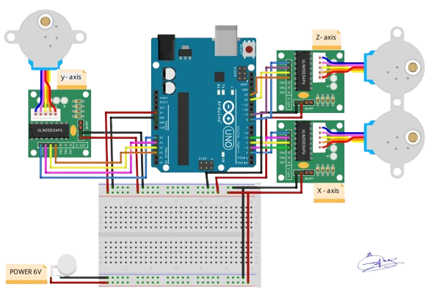
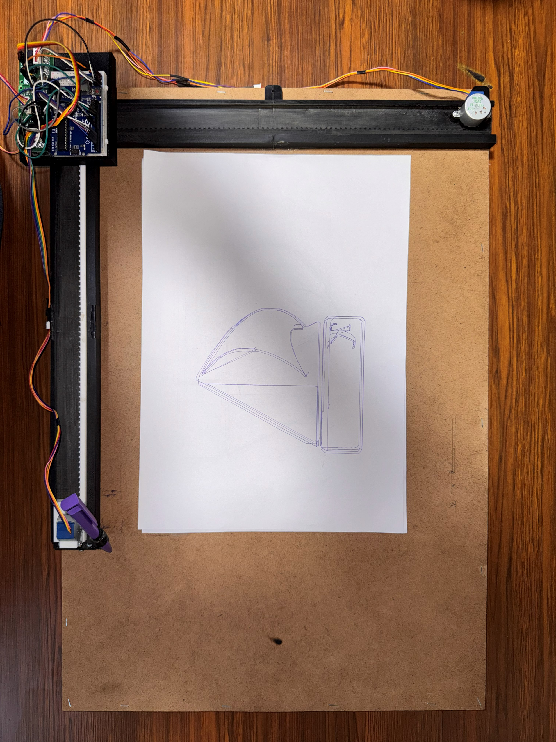
🤖 CNC Plotter
💡Project Idea
A CNC Plotter is a mechatronic system that integrates hardware and software, converting digital commands from a computer into precise mechanical motion using stepper motors, enabling it to draw shapes and write text automatically with high accuracy.
🔌 Connection Method
The system is connected using an Arduino Uno, where each stepper motor is controlled through a ULN2003 driver. The drivers are connected to the Arduino digital pins, and an external 9V power supply is used to ensure stable operation.
⚙️ Components
• Arduino Uno
• 3× Stepper Motor + ULN2003 Driver
• 3D Printed Frame (405g)
• Adapter 9V/1A • USB Cable • Wires

Slide 5
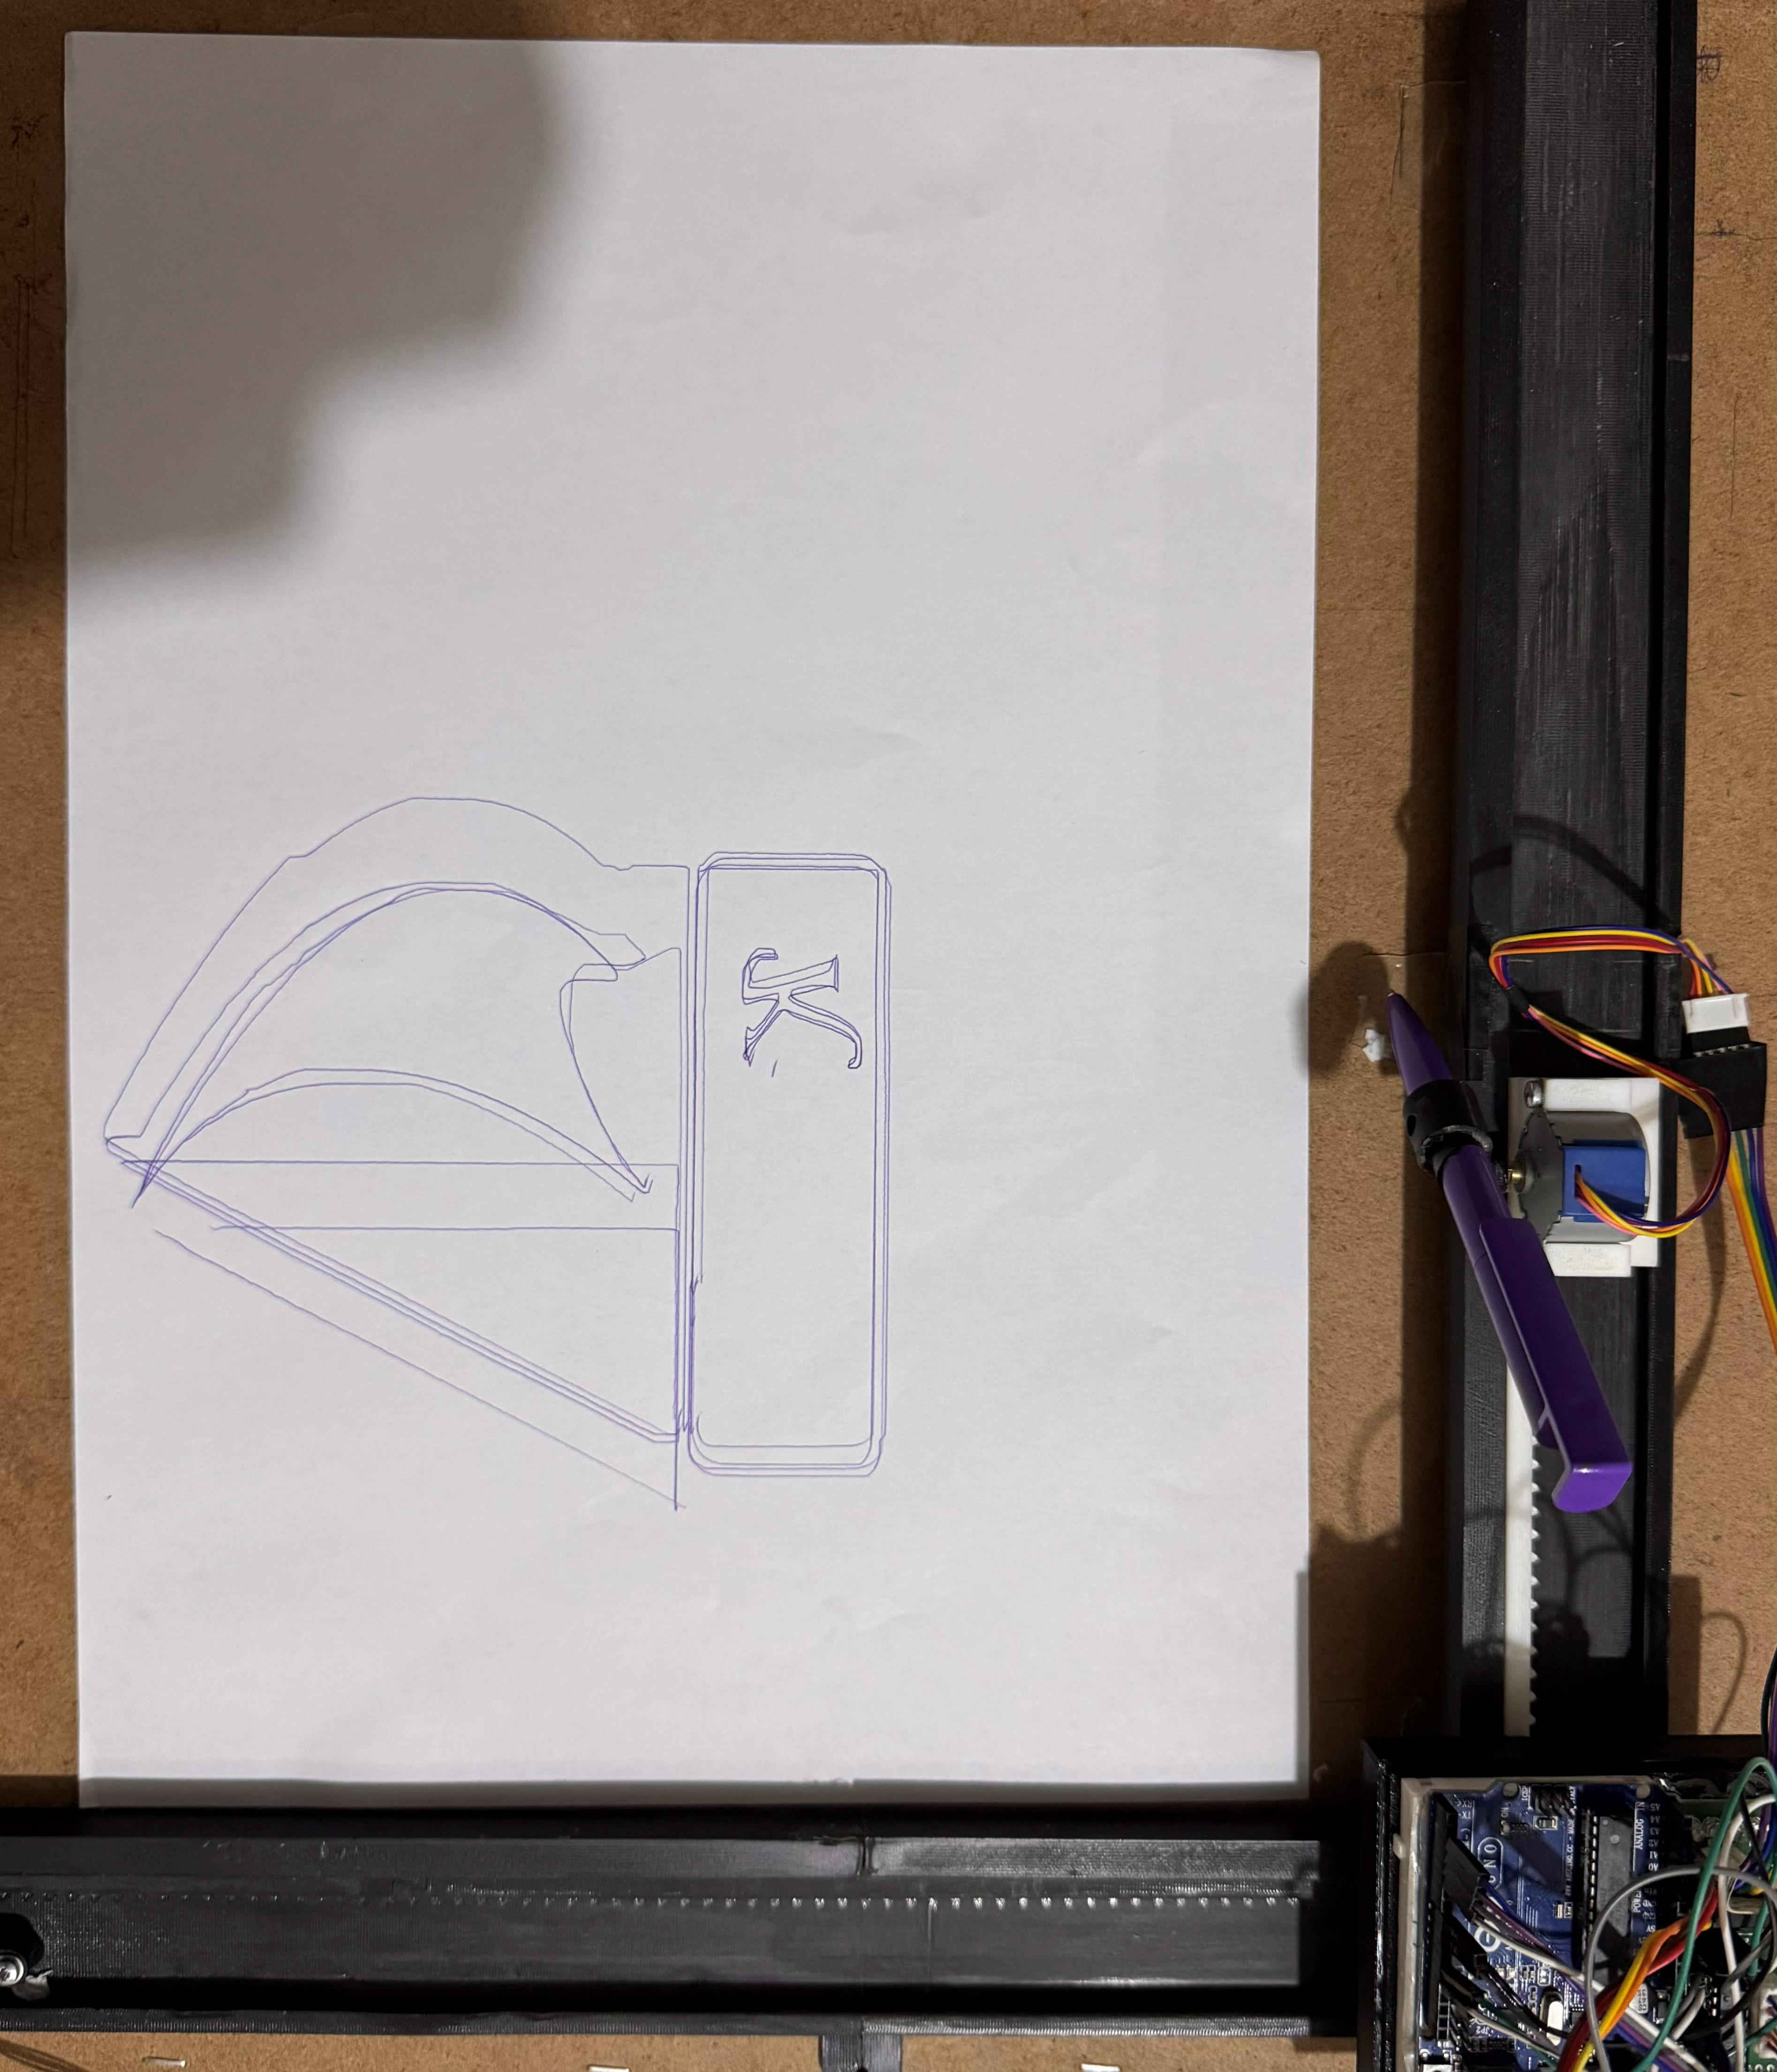
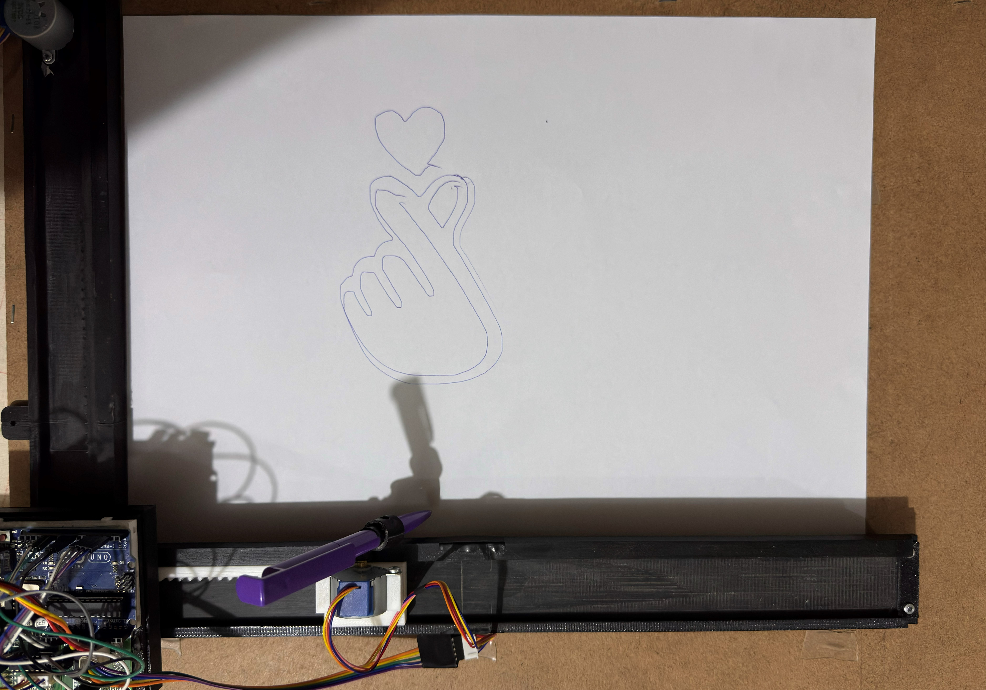
🖼️ CNC Plotter Outputs & Code
Arduino
/***********************************************************************
This sketch compiles and uploads Grbl to your 328p-based Arduino!
To use:
- First make sure you have imported Grbl source code into your Arduino
IDE. There are details on our Github website on how to do this.
- Select your Arduino Board and Serial Port in the Tools drop-down menu.
NOTE: Grbl only officially supports 328p-based Arduinos, like the Uno.
Using other boards will likely not work!
- Then just click 'Upload'. That's it!
For advanced users:
If you'd like to see what else Grbl can do, there are some additional
options for customization and features you can enable or disable.
Navigate your file system to where the Arduino IDE has stored the Grbl
source code files, open the 'config.h' file in your favorite text
editor. Inside are dozens of feature descriptions and #defines. Simply
comment or uncomment the #defines or alter their assigned values, save
your changes, and then click 'Upload' here.
Copyright (c) 2015 Sungeun K. Jeon
Released under the MIT-license. See license.txt for details.
***********************************************************************/
#include <grbl.h>
// Do not alter this file!

Slide 6
💰 Price List (CNC Plotter Components)
PRODUCT / المنتج
Qty / الكمية
PRICE / السعر
3D Printing (405g)
1
1,215 EGP
Adapter 9V / 1A
1
55 EGP
Arduino Uno
1
350 EGP
Stepper Motor + Driver
3
285 EGP
USB Cable
1
20 EGP
Wires
40
30 EGP
TOTAL / الإجمالي
47 pcs
1,955 EGP
💡 Total Budget: 1,955 EGP | Components: 47 pcs | Project: CNC Plotter

